Slide 1





(GUI) Text Editors vs IDEs
The Beauty and Joy of Computing Lecture #20
Besides Blocks II:
Python Data Structures & APIs
Jonathan
McKinsey
www.v3.co.uk/v3-uk/news/2403113/intel-predicts-moores-law-to-last-another-10-years

Slide 2
Python Objects & Sequences

Slide 3
Object-Oriented Programming in Python
A class defines the blueprint of an object and can contain
Properties = values
Functions = actions
E.g. A Rabbit might have properties: name, age functions: eat, sleep
An instance of an object is what you get after you build a blueprint.
E.g Petey is a Rabbit that is 8 months old (8/12 = 0.67 years). >>> petey = Rabbit(“Petey”, 0.67)
To access a property or call a function, use .
E.g. >>> petey.eat(“hay”) >>> Petey eats a lot of hay! Nom nom nom…
period

Slide 4
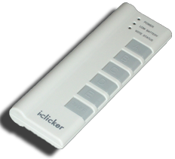
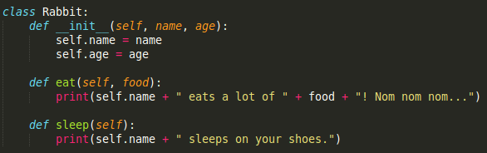
Test your understanding
What happens if we call: petey.sleep()?
self.name + “ sleeps on yours shoes.”
Petey sleeps on yours shoes.
Petey eats a lot of hay! Nom nom nom…
0.67
Notes:
Data and information is hard to define. There are philosophical and meta-physical issues. So let’s all watch the Matrix…

Slide 5
Importing Modules and Getting Help
Importing a class/module that isn’t built-in:
import <module>
E.g. import math
Getting help
help(<type>) or help(<value>) or help(<module>)
E.g. help(int) or help(1) or help(math)
Treating everything as an object
<module/object>.<function>(<args>, …) or <module>.<constant> or <object>.<field>
E.g. “12”.isdigit() or math.pi or (1+2j).real

Slide 6
Python Sequences
str “text in quotes”
list [‘a’, ‘group’ , ‘of’, ‘items’]
tuple (‘a’, ‘group’, ‘of’, ‘items’)
a list that can’t be modified
range(start, stop, step) sequence of #s
Supports very easy iteration:
for item in sequence:
print(item)

Slide 7
Python Sequence (general) Operations
in & not in
+ & *
SEQUENCE[START:END:STEP]
len()
min() & max()
map() filter() & reduce()
count(item)
Many, many more: http://docs.python.org/library/stdtypes.html#typesseq
☑

Slide 8
Python Strings, Lists, Tuples & Ranges

Slide 9
Python Strings
Sequence (or “list” or “array”) of chars
Quoting
Single Quotes, Double Quotes
Triple Quotes (this keeps formatting and line breaks)
Concentration, finding length, etc.
help(str) and help(“string”)
http://docs.python.org/library/stdtypes.html#string-methods

Slide 10
Python Lists
Collection of any type
Indexing mylist[item]
Indices start at 0, NOT 1
Modifying my_list[item] = new_item
Slicing and slicing notation (i.e. [::])
Exactly the same as string notation!
Operators
append(x), insert(i,x), count(x), sort(), etc.
http://docs.python.org/library/stdtypes.html#mutable-sequence-types

Slide 11
Python Tuples & Ranges
Tuples mostly like Lists except () not []
Except they can’t be changed (like strings)
This immutability will be helpful in dictionaries
Ranges are virtual sequences of #s
Useful and fast
They don’t actually exist until you need them
Use list(range(<args>)) to see it

Slide 12
Brief Tangent on Variables

Slide 13
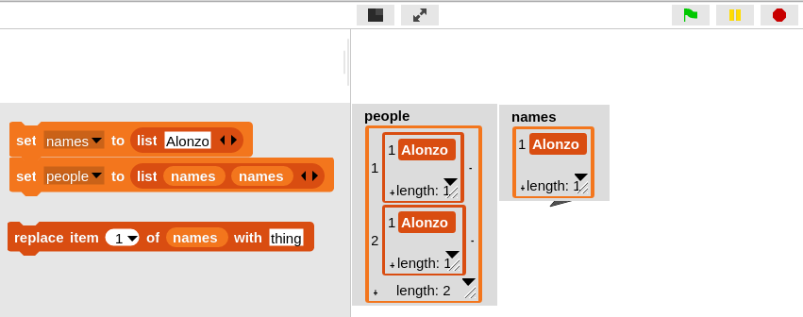
Clicker Question
What is people after clicking the “replace” command?
((Alonzo) (Alonzo))
((Alonzo) (thing))
((thing) (Alonzo))
((thing) (thing))
Error
Notes:
Data and information is hard to define. There are philosophical and meta-physical issues. So let’s all watch the Matrix…

Slide 14
Clicker Question
What is people after clicking the “replace” command?
[[“Alonzo”], [“Alonzo”]]
[[“Alonzo”], [“thing”]]
[[“thing”], [“Alonzo”]]
[[“thing”], [“thing”]]
Error
>>> names = [“Alonzo”]
>>> people = [names, names]
>>> people
[[‘Alonzo'], [‘Alonzo']]
>>> names[0] = “thing”
Notes:
Data and information is hard to define. There are philosophical and meta-physical issues. So let’s all watch the Matrix…

Slide 15
Python Dictionaries

Slide 16
Python Dictionaries (dict)
Very fast access (by key, not number)
Mapping from a key to a value
Syntax
{ key1 : value1, key2 : value2, … }
Adding elements dict[key] = value
Accessing elements dict[key]
Keys
Looking for specific keys (“in”)
Iterating over (iterkeys())

Slide 17
Python HOFs & APIs

Slide 18
Python APIs
find-us.herokuapp.com
“Application Programming Interface”
Set of agreements for sharing information
Programming APIs (i.e., how to use modules)
E.g., Building Blocks for common elements such as Open or Save prompts
Web APIs
“Special” URLs for accessing data directly
Example: Jeopardy API
http://jservice.io/api/random
Example: Missing Persons API
find-us.herokuapp.com

Slide 19
Demo (reference)
Code files are all on the class website
fractals.py
Some fractals in Turtle Graphics
jeopardyAPI.py
Standalone text-based Jeopardy game
tttAPI.py
Tic-Tac-Toe in Python
Games Crafters API for information about best moves

Slide 20
More Information
Online Python Tutor (invaluable!!)
http://www.pythontutor.com/
Sequences & Methods
http://docs.python.org/library/stdtypes.html
Coding Bat (Great practice!)
http://codingbat.com/python

